Slide 1
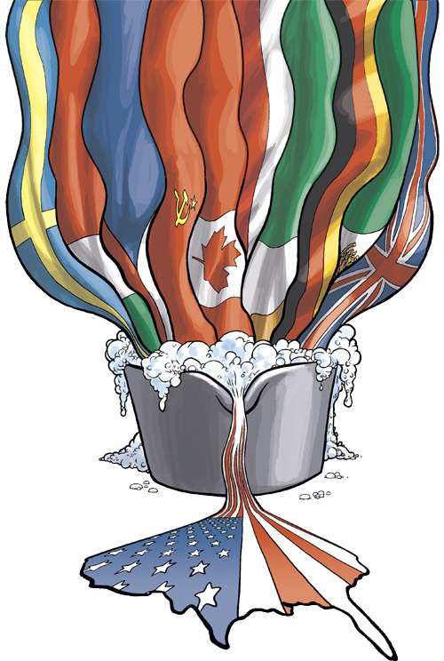
1) What do you see in the cartoon? Describe it.
2) What do you think it means?
3) Why do you think the artist created it?

Slide 2
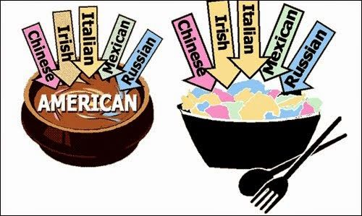
Melting Pot or Salad Bowl?

Slide 3
NATURALIZATION QUIZ
What is the Supreme Law of the Land?
A) Constitution
B) Declaration of Independence
C) The Presidency

Slide 4
NATURALIZATION QUIZ
What does the Constitution do?
A) Declared independence from Britain
B) Sets up and defines our government
C) Tells us which Presidents to elect

Slide 5
NATURALIZATION QUIZ
What is one power belonging only to the federal government?
A) To set up schools
B) To tax
C) To print money

Slide 6
NATURALIZATION QUIZ
How many amendments does the Constitution have?
A) 10
B) 27
C) 34

Slide 7
NATURALIZATION QUIZ
When was the Constitution written?
A) 1776
B) 1787
C) 1861

Slide 8
Did you pass the test?
In order to become a citizen, immigrants/aliens/residents in the United States are required to take a Naturalization Test.
To pass the civics portion of the United States Naturalization Test you are required to get 60% of the questions correct.

Slide 9
What does it mean to be a citizen?
Citizen: A legally recognized member of a country.
What does being a citizen mean to you?

Slide 10
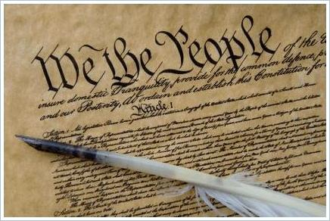
What does the Constitution of the United States Say about citizenship?
The Constitution is like a rule book for government: it outlines the structure and function of our government and names some of the rights of the people.

Slide 11
The Fourteenth Amendment
Defines citizens as “all persons born or naturalized in the United States”

Slide 12
Natural Born Citizens
Who is a natural born citizen of the United States?

Slide 13
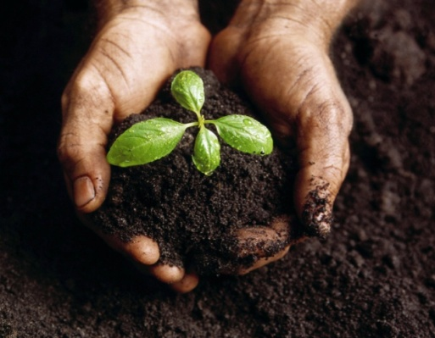
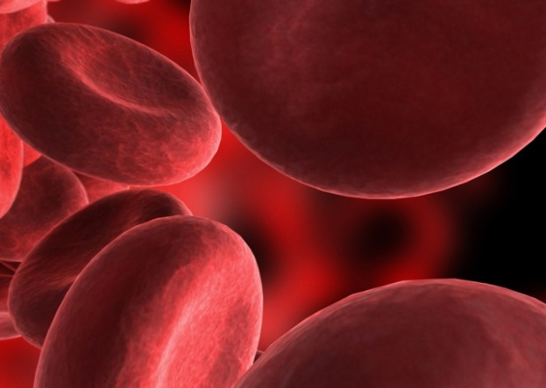
Natural Born Citizenship is based on two “laws”:
“Law of Blood”
Children born to a parent or parents who are United States citizens.
“Law of Soil”
Children born in the United States or Territories/Possessions
S
B

Slide 14

“Law of the Blood”
Principle in which citizenship is determined by parentage rather than by place of birth.
The U.S. recognizes children born abroad to American citizens as citizens.

Slide 15
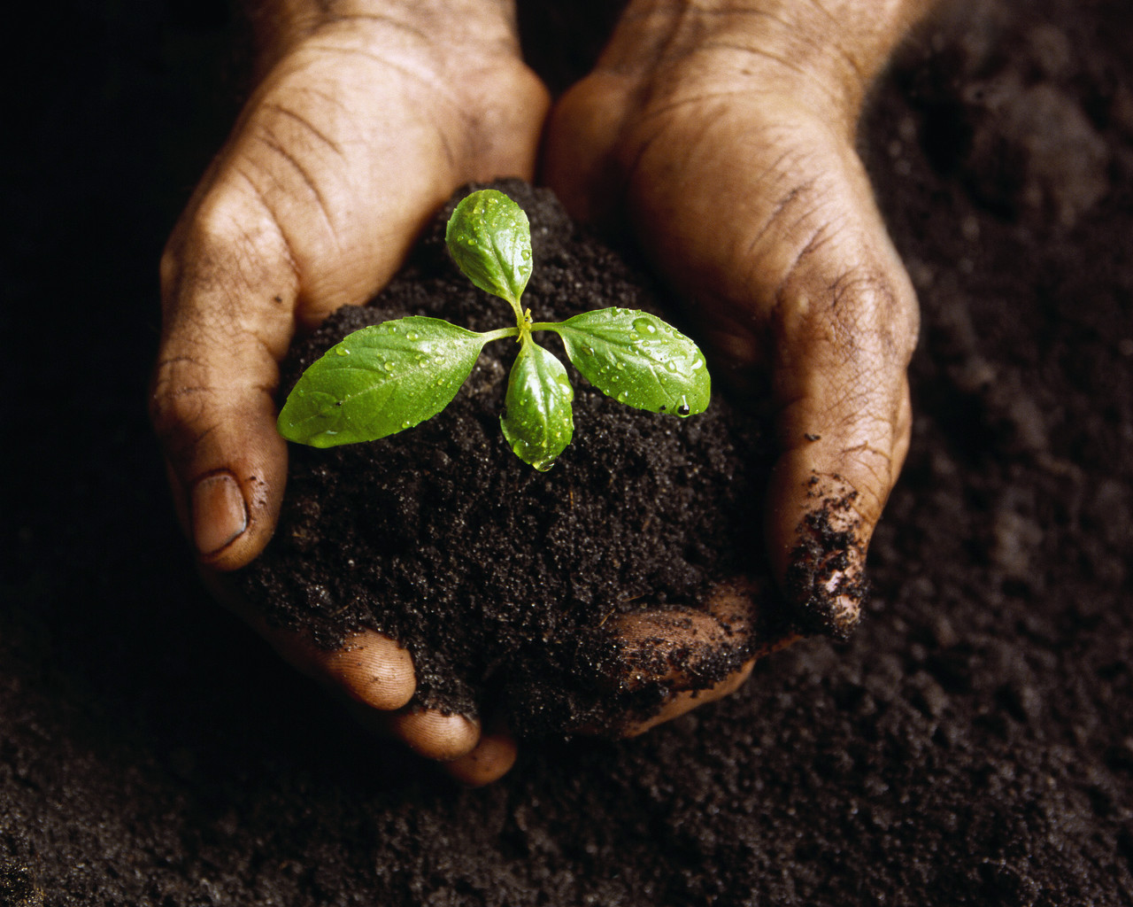
“Law of the Soil”
Any child born in the United States is a citizen of the United States, even if the child’s parents are not citizens.
Soil of the U.S. includes Puerto Rico, Guam, the Virgin Islands, and the Northern Mariana Islands.

Slide 16


To Sum It Up…
Law of Soil – WHERE you are born (must be within the United States or territory/possession)
Law of Blood – WHO you are born to
S
B

Slide 17
NATURALIZATION
How someone can become a citizen of the United States.

Slide 18
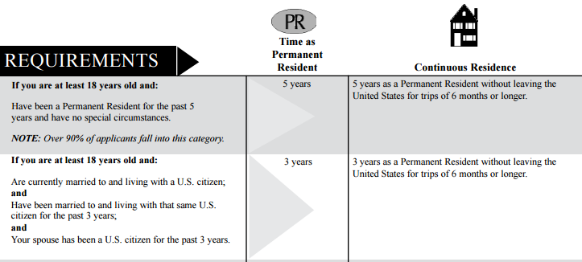
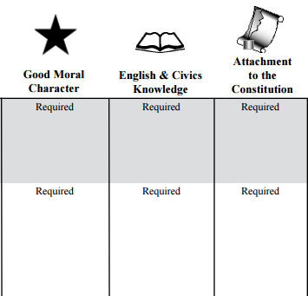
To Become a Naturalized Citizen…
There are special considerations for those who serve in the military or served during times of war/conflict.
Notes:
Go over the chart provided to explain the naturalization process. Permanent residents also must establish “continuous residence” in the U.S., meaning they cannot leave the country for trips longer than 6 months.

Slide 19
Defining Immigrants, Residents, and Aliens
Immigrant
Alien
A person who comes to live permanently in a foreign country.
A resident is someone who has been legally allowed to live in the United States, but is not a citizen
Any person not a citizen or national of the United States.
Resident

Slide 20
CLASSWORK/HOMEWORK
Imagine that you have just become a naturalized citizen of the U.S. Write a letter to a friend in the country in which you were born, explaining why and how you became a U.S. citizen.
Write at least 4 sentences. Be creative!

